Slide 1
Sorting
CS240 Spring 2019

Slide 2
Concerns
We began the semester with bogosort
When sorting, time isn’t the only concern:
Extra memory requirements
Internal vs. external sorting
Stable vs. unstable sorts
Runtime complexity
N² vs. Nlog₂N performance
worst case vs. average case

Slide 3
Memory
Memory Requirements
In-Place Sort vs Out-of-Place Sort
Does your algorithm need additional memory to sort?
Do you need all the data to sort?
Internal sorting algorithm
the entire data to be sorted can be held in the computer's main memory.
External sorting algorithm
when the data cannot be stored in memory
example: a very large transaction file which is stored over the network or on disc

Slide 4
Stable Sort vs Unstable Sort
An algorithm is said to be stable if for any items in the unsorted list that are equivalent, their original order is maintained
Example
sorting only numbers
Stable: [ 3, 2a, 2b, 1] => [1, 2a, 2b, 3]
Unstable: [ 3, 2a, 2b, 1] => [1, 2b, 2a, 3]

Slide 5
Simple Sorting
For any sort algorithm, the resulting dataset must be a permutation of the original dataset
Must not add or subtract any elements
O(n²) - Quadratic Sorts
Run through every element of an unsorted array and compare it (possibly swap) with every other element in the array
Generally slow for large data sets
Why would you use slower sort?
easy and fast to code, performs better on certain kinds of datasets

Slide 6
Bubble
Bubblesort starts at the beginning
if the first element is greater than the second element, it swaps them.
It continues doing this for each pair of adjacent elements to the end of the data set.
It then starts again with the first two elements, repeating until no swaps have occurred on the last pass.
Visualizing Bubble Sort
https://visualgo.net/sorting

Slide 7
Bubblesort Pseudocode
while(swapped) swapped = false for i => n if a[j] < a[j-1] swap a[j,j-1] swapped = true

Slide 8
BubbleSort
Average case: O(n ² )
Worst case: O(n ² )
Use Case:
Use on a list that is already sorted except for a very small number of elements.
Example: if only one element is not in order, bubble sort will take only 2n time.
That’s linear sort!

Slide 9
Selection Sort Pseudocode
for i = 0:n
min = i
for j = i+1:n
if a[j] < a[min]
min = j
swap a[i,min] end

Slide 10
Selection Sort
Average case: O(n ² )
Worst case:O(n ² )
Use Case:
Use on hardware where swapping is an expensive operation
Does no more than n swaps
In practice, the slowest sort

Slide 11
Insertion Sort
for (i = 1:n) for (j = i; j>0 and a[j]<a[j-1]; j--) swap a[j,j-1] end

Slide 12
Insertion
Insertion sort works by
taking an element from the list
inserting the element in their correct position into a new sorted list.

Slide 13
Insertion Sort
Average case: n ²
Worst case: n ²
Stable Sort
Element order stays the same for equal elements
Use Case:
Insertion sort is also called natural sort
Mimics natural sorting of cards
Generally the fastest of the Quadratic sorts
depending on implementation
Also efficient on nearly sorted, like bubble sort
don’t need the swapped flag

Slide 14
Logarithmic Sorts
nlogn sorts use top down sorting techniques
Also known as a divide and conquer sort
Generally,
more difficult to code
fast for large data sets, slow for small datasets

Slide 15
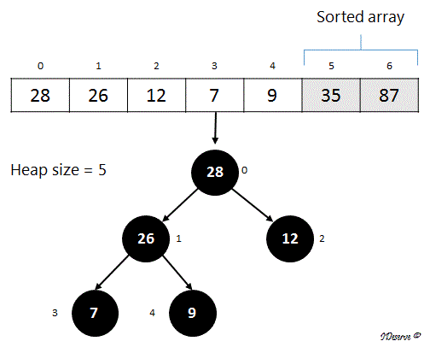
Heapsort
Sort a list by building it into a heap, then deleting the root node and placing it 1 past the last heap index until the heap is empty.
This is an in place sort
Doesn’t require an additional list to hold the sorted value

Slide 16
Heapsort
void HeapSort(int* list, int size) { MinHeap toSort(list, size); toSort.buildHeap(); for(int i = size - 1; !toSort.empty(); i--){ list[i] = toSort.removeRoot(); } }

Slide 17
Cost of Heapsort
Complexity
Total Comparisons: NlogN
Total Swaps: NlogN
Heap Sort is T(n) = c(NlogN)
Unstable Sort

Slide 18
What do you notice?
arr1
arr2
arr3
arr4
36
What can you say about arrays of 1?
They are sorted arrays
How long would it take to merge arr1 and arr2?
Take arr1.length + arr2.length time
0
Each of these is a sorted array
17
42

Slide 19
MergeSort
Two properties of lists allow mergesort to sort quickly:
A list containing 1 item is a sorted list
Merging 2 sorted lists into a new sorted list is an linear operation
Splitting a list into two lists is a logn operation
Think of binary search

Slide 20
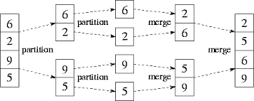
MergeSort
Average case: nlogn
Worst case: nlogn
Stable Sort
Mergesort has two parts
Divide list into two lists
Merge two sorted lists

Slide 21
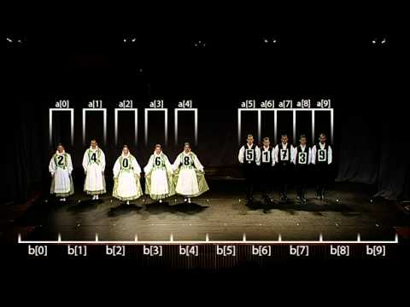

Slide 22
Merging 2 sorted arrays
Given the pseudocode on the right, how many times are we going to loop?
no more than left->size + right->size
Merging 2 sorted arrays is a linear operation
O(m+n)
where m,n are the size of the 2 arrays
merge( left, right )
new sorted_array[ left->size + right->size ]
i, j, k = 0;
while ( i != left->size() and j != right->size() )
if(left[i] > right[j] )
sorted_array[k] = right[j])
increment j and k
else
sorted_array[k] = left[i])
increment i and k
while ( left or right has elements )
sorted_array[i] = remaining_elements;
increment i
return sorted_array

Slide 23
Classwork
mergesort( array a )
if ( a->size == 1 ) return a
array_left = {a[0] ... a[n/2]}
array_right = {a[n/2+1] ... a[n]}
array_left = mergesort(array_left)
array_right = mergesort(array_right)
sorted_array = merge( array_left, array_right)
return sorted_array;
Merge Function

Slide 24
What do you notice?
Choose a ‘pivot’, which can be any index in an array, and move all values ‘greater than’ to one side, and all values, ‘less than’ to the other
4
8
1
3
7
2
5
5 is in its sorted position
4
1
3
2
5
8
7
2 is in its sorted position
1
2
4
3
5
8
7

Slide 25
Quicksort
Quicksort is a divide and conquer algorithm
relies on partitioning
Using a pivot, all elements smaller than the pivot are moved before it and all greater elements are moved after it.
The lesser and greater sublists are then recursively sorted.

Slide 26
Quicksort
quicksort(array, low, high):
if low < high:
sorted = partition(array, low, high)
quicksort(array, low, sorted - 1)
quicksort(array, sorted + 1, high)

Slide 27
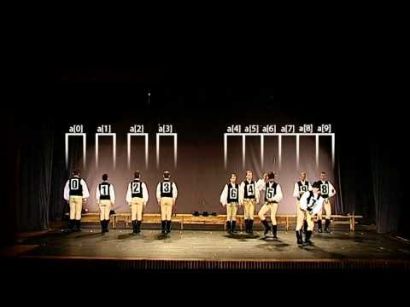

Slide 28
Implementing a Partition
partition(array, low, high)
pivot = choosePivot(low, high)
swap array[pivot, high]
marker = low
for i = low to (high−1)
if array[i] < array[high]
swap array[i, marker]
marker = marker + 1
swap array[marker, high]
return marker
Dividing the array along a pivot is called partitioning
‘high’ and ‘low’ are the indexes you are working within the array
Remember, quicksort is in place, so we divide up the existing array
The comparison is with the pivot, the swap is with the marker and the current index

Slide 29
Partition Algorithm
There are several different algorithms you can use to partition on a pivot
Each with pros and cons
The video uses a pivot swap where you keep swapping the pivot until it is the correct position
The partition pseudocode swaps values lesser and greater than the pivot, then puts the pivot into place

Slide 30
Classwork
int pivotA(low, high):
return low
int pivotB(low, high):
//findMedian() loops through to find
// the median value in the array
return findMedian(low,high)
int pivotC(low, high):
return random(low, high)
Quicksort

Slide 31
What do you notice?
1
2
3
4
5
6
7
1
2
3
4
5
6
7
1
2
3
4
5
6
7
Must compare every element against every other element

Slide 32
Choosing a bad Pivot
consistently poor choices of pivots can result in dramatically slower O(n²)
Pivot on first/last element on already sorted or nearly sorted lists?
Always choosing the lowest or highest value?

Slide 33
Choosing a pivot
Options for choosing a good pivot
Finding the median, use as the pivot O(n log n).
Finding the median however, is an O(n) operation, therefore O(n2)
Select the center,
1/n chance for worst case complexity
Randomly select the pivot
drastically reduce worst case possibility

Slide 34
choosePivot
choosePivot(low, high)
int pivot = low + random() % (high - low);
return pivot

Slide 35
QuickSort
Average case: O(nlogn )
Worst case:O(n²)
Unstable Sort
The fastest sort algorithm in practice.
Use Case:
Any large, unsorted dataset
in place sort, Unlike mergesort, n space usage

